Slide 1
Performance
Dr. Ergun Simsek (simsek@umbc.edu)
Lecture 2

Slide 2
PERFORMANCE
What is it?
Why do we care?
When we say one computer has better performance than another, what do we really mean?
Does your code work faster on a MacBook Pro or an HP Spectre?
MacBook Pro or HP Spectre?

Slide 3
Levels of Transformation
“The purpose of computing is insight”
Richard Hamming
Sample Problem: Finding the optimum path between two addresses during rush hour
We solve this problem with electrons!
Problem
Algorithm
Program/Language
Runtime System
(VM, OS, MM)
ISA (Architecture)
Abstraction *
Microarchitecture
Logic
Electronics
Electrons
* A higher level only needs to know about the interface to the lower level, not how the lower level is implemented
If abstraction is great, then why would you want to know what goes on underneath or above?
Notes:
Algorithm: step by step procedure where each step is effectively computable (by a computer), is definite (precisely defined)

Slide 4
Crossing the Abstraction Layers
As long as everything goes well, not knowing what happens in the underlying level (or above) is not a problem.
What if
The program you wrote is running slow?
The program you wrote does not run correctly?
The program you wrote consumes too much energy?
What if
The hardware you designed is too hard to program?
The hardware you designed is too slow because it does not provide the right primitives to the software?
What if
You want to design a much more efficient and higher performance system?
Notes:
Figure 1.10.1: Optimizations of matrix multiply program in Python in the chapters of this book

Slide 5
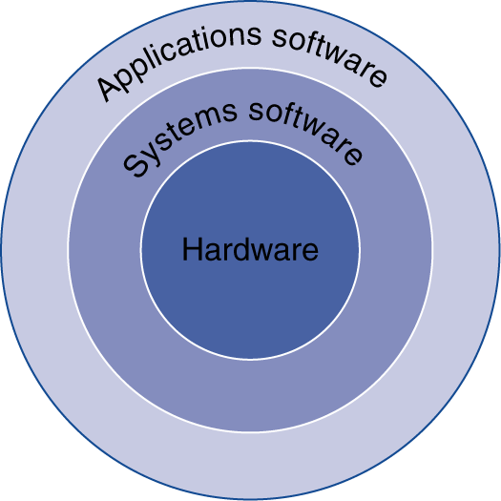
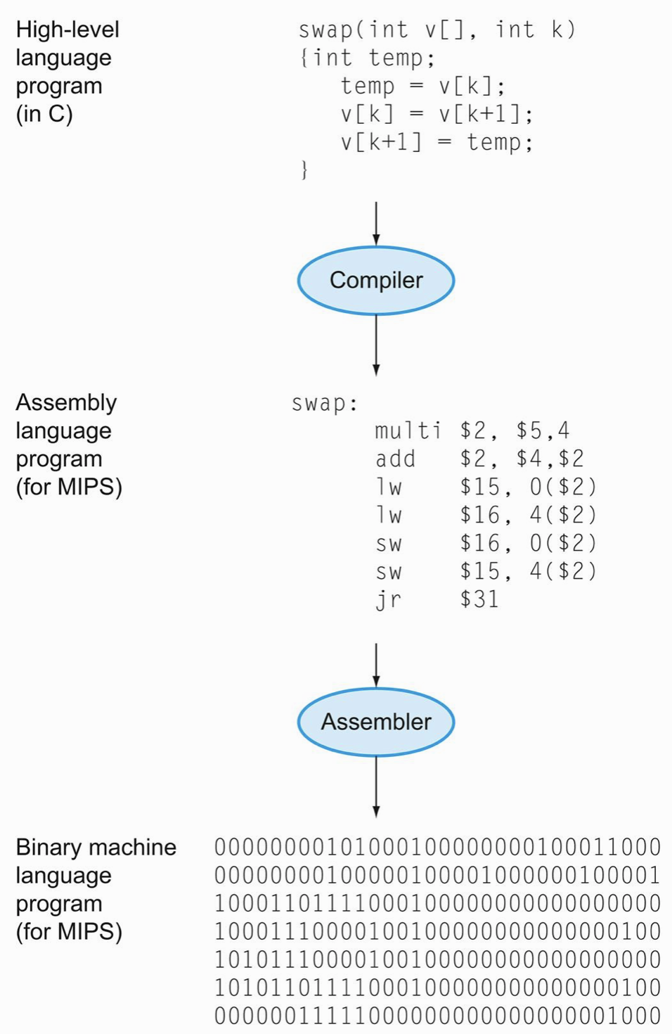
Below Your Program
A programmer writes a high-level language (HLL) program
A compiler converts the (HLL) program to an assembly language program
An assembler converts the assembly language program into a binary machine language program
Can we write this function in a more efficient way? Should we use another language?
Would another compiler or ISA lead to less # of inst.s? Is using 64-bits good idea?

Slide 6
This’s Why We Care About Performance
To make intelligent design choices
Key to understanding underlying computer organization
Why is some hardware faster than others for different programs?
What factors of system performance are hardware related?
e.g., Do we need a new machine or more RAM or a GPU
… or a new operating system?
How does a machine’s instruction set affect its performance?
Does your code work faster on a MacBook Pro or an HP Spectre?
Algorithm
Programming language, compiler, architecture
Processor and memory system
I/O system (including OS)

Slide 7
What is Performance?
Loosely:
How fast can a computer complete a task
Examples of “tasks”:
Short tasks:
Crunch a bunch of numbers (say calculate mean)
Display a PDF document
Respond to a game console button press
Longer ones:
Video editing
Numerical optimization
Large-scale inversion
Our main parameter to measure performance will be TIME
Let’s make some definitions

Slide 8
Execution Time vs Throughput
Response time
or ~Execution time
or ~Latency
Throughput
or Bandwidth
The total time required to complete a task
The number of tasks completed per unit time
Cars drive 60 km/h over a 1 km long bridge. A car thus requires 1 minute to cross the bridge. Cars stay separated by about 100 m, so 1 car enters and another exits the bridge every 6 seconds.
Task = Crossing the bridge
The execution time is
The throughput is
1 minute
10 cars/minute

Slide 9
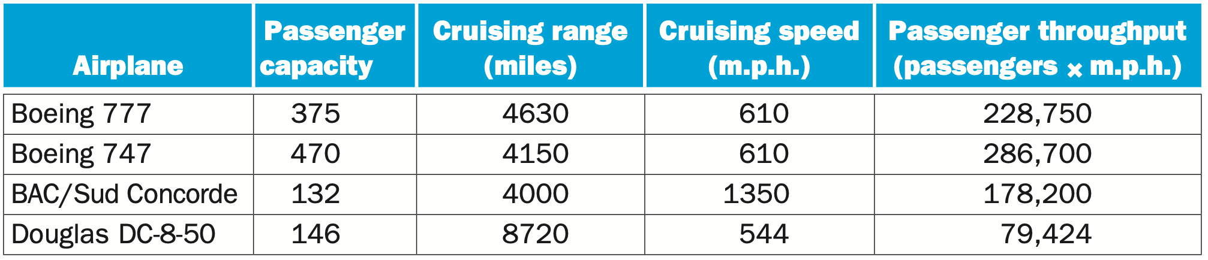
Which airplane is the “best”?
How much larger is the 747’s capacity than the Concorde?
3.6 X (“X” means “factor of”)
How much faster is the Concorde than the 747?
2.2 X
It is roughly 4000 miles from Baltimore to Barcelona. If our goal is evacuating as many people as possible from Baltimore to Barcelona, which airplane would you use?
Boeing 747’s throughput
Concorde’s throughput
Notes:
DC – Tokyo = 7k miles

Slide 10
Execution Time in Computing!
Elapsed Time/Wall Clock Time
counts everything (disk and memory accesses, I/O, etc.)
includes the impact of other programs
a useful number, but often not good for comparison purposes
CPU time
does not include I/O or time spent running other programs
can be broken up into system time and user time
Our focus: user CPU time
time spent executing actual instructions of “our” program
Let’s look at these definitions more closely

Slide 11
Time as a Measure of Computer Performance
The total time to complete a task (include everything) is called
Program execution time
Wall clock
time
Response time
Elapsed
time
=
=
=
The actual time the CPU spends computing for a specific task (include holds/waits at the CPU but not I/O) is called
CPU execution time
CPU
time
=

Slide 12
Time as a Measure of Computer Performance
User
CPU time
The CPU time spent in a program itself (does not include holds/waits or IO)
System
CPU time
The CPU time spent in the operating system performing tasks on behalf of the program
On a RISC device with a single processor
Program execution time
System
CPU time
=

Slide 13
Example
A task runs alone on a CPU.
The task starts by running for 5 ms.
The task then waits for 4 ms while the operating system runs some instructions to access disk.
The CPU is then idle for 2 ms while waiting for data from disk.
Finally, the task runs another 10 ms and completes.
Elapsed time = System performance
CPU time
User CPU time = CPU performance
= 5 + 4 + 2 + 10 = 21 ms
= 5 + 4 + 10 = 19 ms
= 5 + 10 = 15 ms

Slide 14
Design Tradeoffs
Performance is rarely the sole factor.
What are the other factors?
Cost
Energy/power consumption
Frequently used compound metrics
Performance/Cost (throughput/$)
Performance/Power (throughput/watt)
Work/Energy (total work done per joule)
for battery-powered devices
Notes:
Power = Work per unit time

Slide 15
Performance
For some program running on machine X,
Performance_{X} = Program Executions / Time_{X} (executions/sec)
= 1 / Execution Time_{X}
Relative Performance
"X is n times faster than Y”
Performance_{X} / Performance_{Y} = n
Example:
Machine A runs a program in 20 seconds
Machine B runs the same program in 25 seconds
By how much is A faster than B?
Performance_{A} = 1/20
Performance_{B} = 1/25
(1/20)/(1/25) = 1.25
Machine A is 1.25 times faster than Machine B

Slide 16
Performance: Pitfalls of using %
Same Example:
By how much is B slower than A?
Correct answer is: B is (Perf_{B}-Perf_{A})/Per_{A} faster/slower
(0.04 - 0.05) / (0.05) = -20% faster = 20% slower
A is 25% faster than B; B is 20% slower
Some people find percentages confusing. We better use ratios.
Also: percentages are only good up to 100%
Don’t say A is 13000% faster than B

Slide 17
CPU Clocking
Operation of digital hardware governed by a constant-rate clock
Clock period
Clock (cycles)
Data transfer and computation
Update state
Clock period: duration of a clock cycle
e.g., 270ps = 0.27ns = 270×10^{–12}s
Clock frequency (rate): cycles per second
e.g., 1/(0.27ns) = 3.7GHz = 3700MHz = 3.7×10⁹Hz

Slide 18
Program Clock Cycles
Instead of reporting execution time in seconds, we often use clock cycle counts
Why? A newer generation of the same processor…
Often has the same cycle counts for the same program
But often has different clock speed (ex, 1 GHz changes to 1.5 GHz)
Clock “ticks” indicate when machine state changes
an abstraction: allows time to be discrete instead of continuous
time

Slide 19
Instruction Count and CPI
Instruction Count for a program
Determined by
program
Instruction set architecture (ISA)
compiler
Average cycles per instruction (“CPI”)
Determined by CPU hardware
If different instructions have different CPI
Average CPI affected by instruction mix

